Slide 1
What Is Worth Fighting For
Yijie Guo

Slide 2
Interest Area
Machine Learning
Artificial Intelligence
Computer Graphics
Scientific Computation
Courses: Machine Learning, Data Mining Computer Graphics, Image Processing

Slide 3
Skills and Strength
Skills
[1] Programming Language: C++, Matlab, Python, etc
[2] Tools: VS, XCode, Cocos2d-x, Unreal, Unity
Strength
[1] Quick Learner, Strong Responsibility
[2] Professional Coding, Fast Prototyping, Excellent Debugging Skills
[3] Outstanding Communications !!!

Slide 4
Work Experiences
Research Assistant
[1] Markov Logic Network
[2] Probabilistic Logic and Satisfaction
[3] Video Analysis

Slide 5
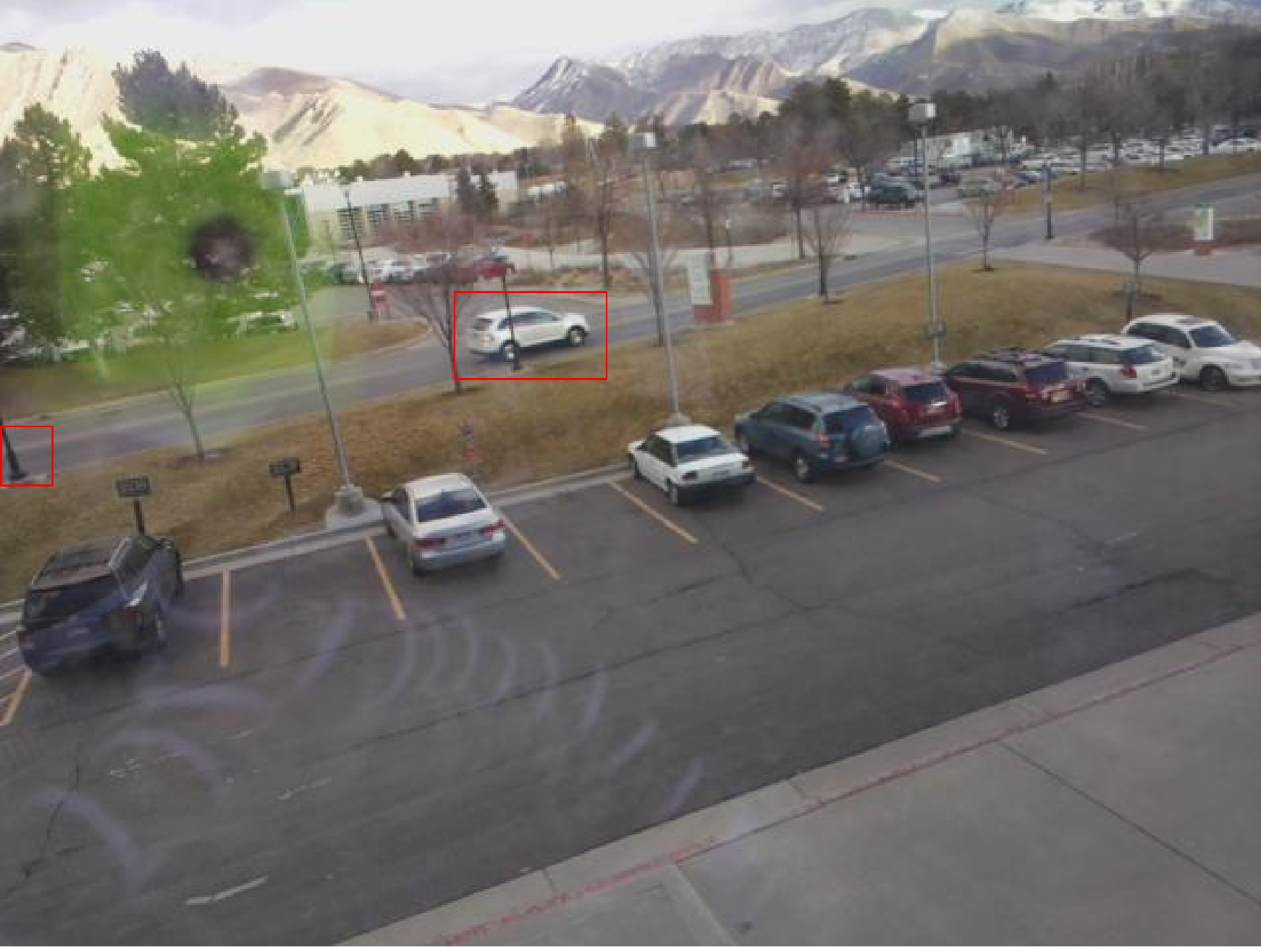
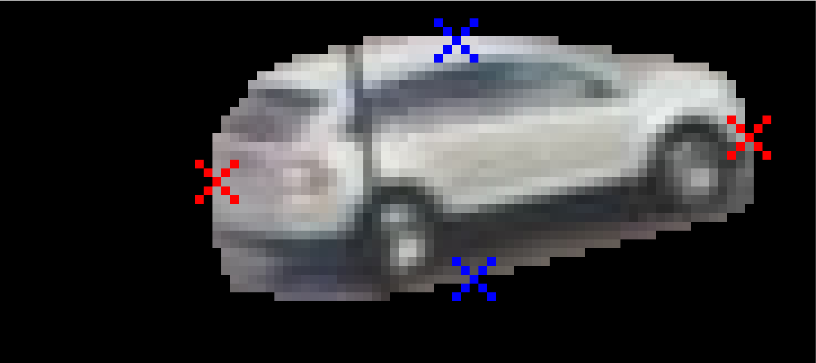
Work Experiences

Slide 6
Work Experiences
Gameplay and Engine Programmer
[1] Graphics, Physics, Event Dispatcher, etc
[2] Gameplay, AI, UI, etc
[3] Mobile Development

Slide 7
Project Idea
iOS Application
Using ML and AR to assist users in decorating rooms
ML learns environments and identify objects
AR allows users interacting with objects without actual touching them
Apps import new virtual objects into real space.

Slide 8
Team Info
We are Recruiting
iOS Developer
[1] Familiar with Swift, Objective-C or C++ and Cocoa API
[2] Experienced in deploying and debugging Apps on iOS Devices
Writer & QA
[1] Grade A Required in WRTG 3014 Scientific Writing
[2] Quick Learner being Familiar with ML
[3] Good Debugging and Problem Analyzing Capabilities

Slide 9
Team Info
We can Offer
[1] Flexible Schedule for Busy but Reliable Experts
[2] Off Campus Meeting at Trolley Square
[3] Free Coffee and Free Pizza
[4] Extra helps for all courses, which team members have taken

Slide 10
Thank you
Yijie Guo

